Slide 1





Group 6 Our Favorite NBA Teams
NOTE:
To change images on this slide, select a picture and delete it. Then click the Insert Picture icon
in the placeholder to insert your own image.
Compton Chester JR
Andi mysllinj
Andrew Li
Mabeyda Martinez
Darrell Reives

Slide 2

Choosing a Topic
We had to discuss had to choose a topic that we were all familiar with yet something that others could relate to.
No matter who you are or where you live you have heard of the NBA.
We decided to share with you our favorite teams.

Slide 3
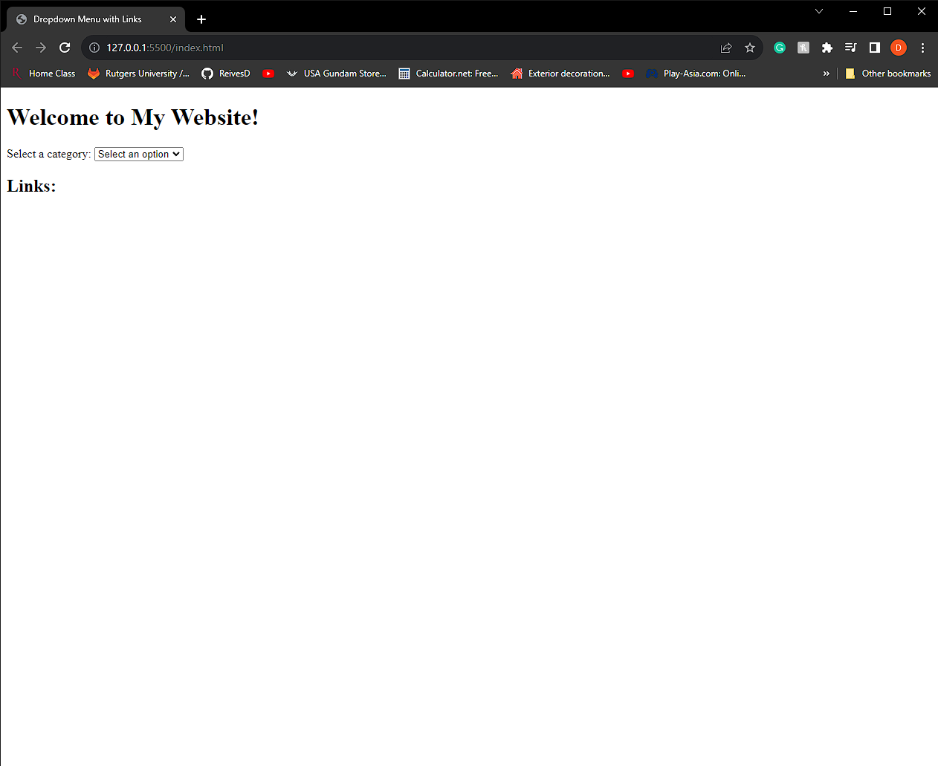
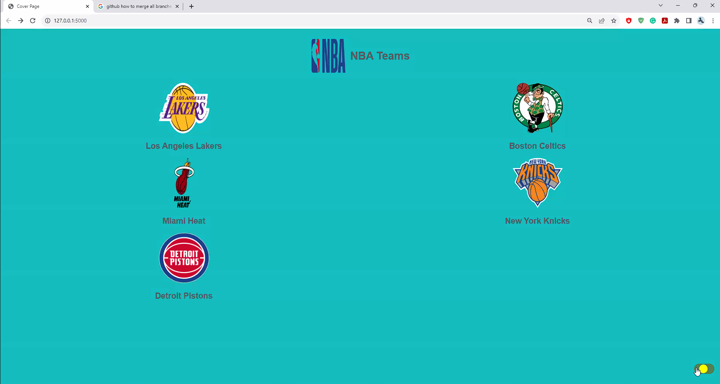
The Steps
How we went from this
Gathering Data
Cleaning the Data
Importing to SQL
Coding
…and more coding…
<p style="font-family: 'Comic Sans MS’;”>and even more coding... <span style="color: green;">and even more coding</span>!</p>
OOPS… you get it.
To This

Slide 4
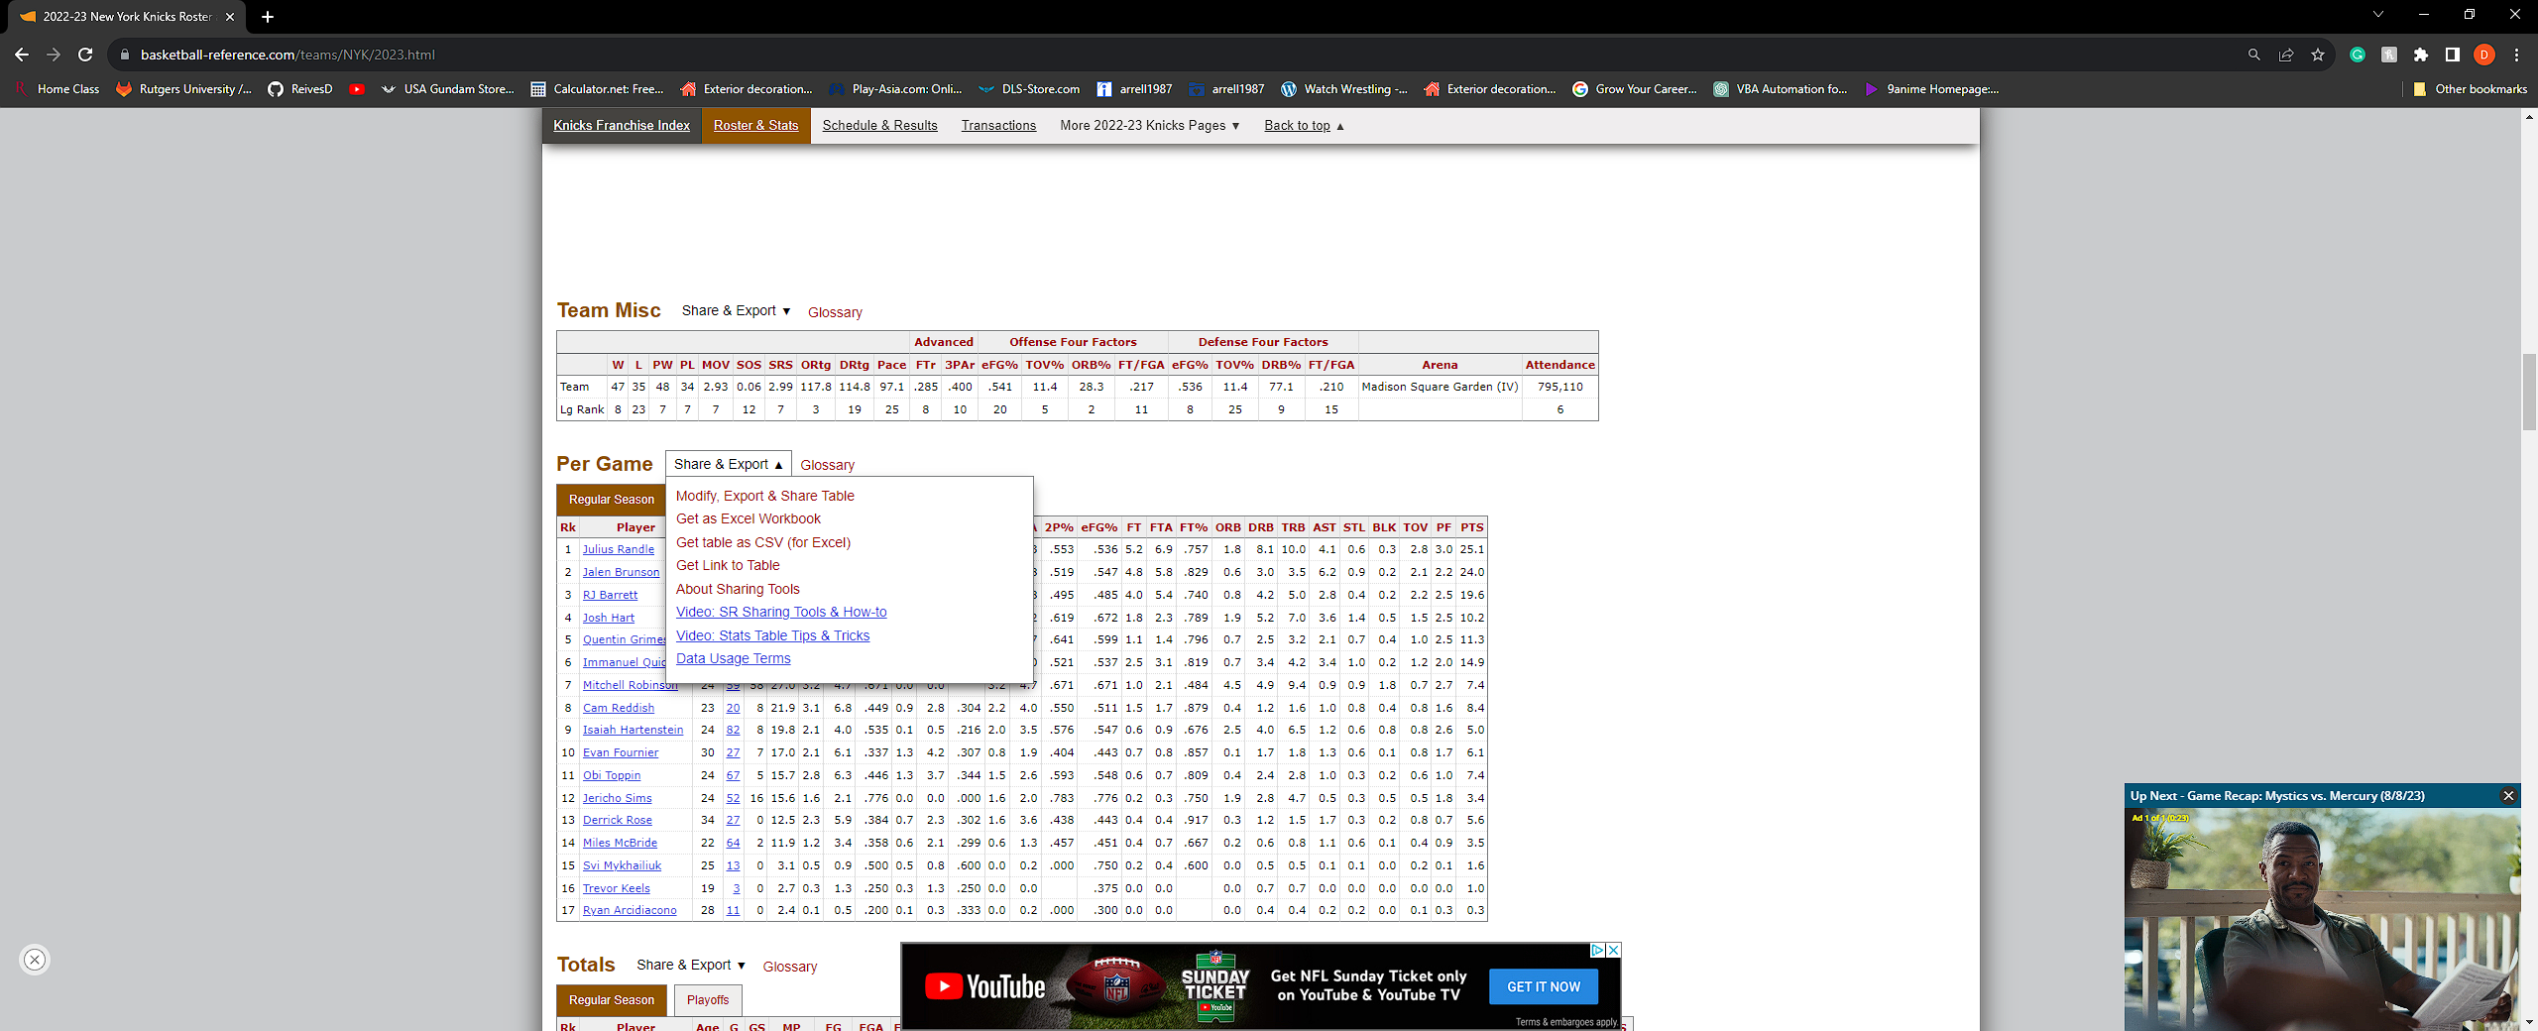
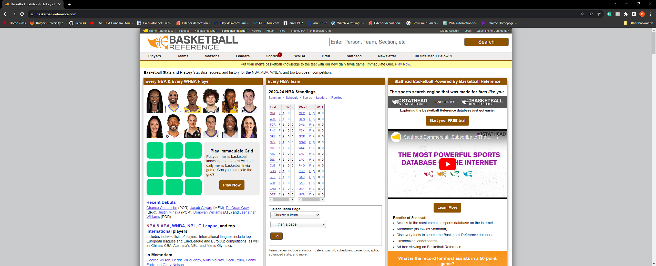
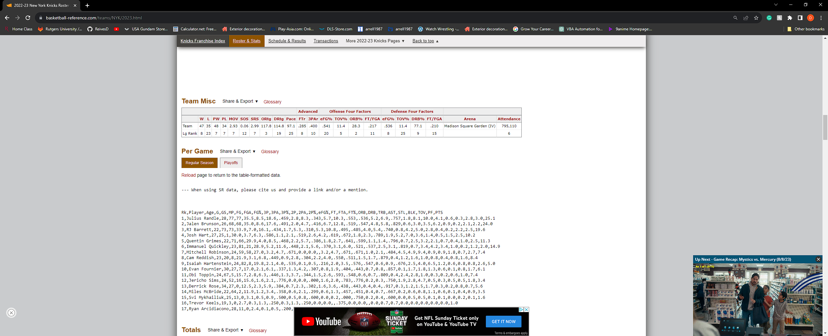

Gathering Data
Thanks to the work the creators put into their site we were able to gather the data on our teams most recent season with out much effort.
We first found the stats for our teams
We were able to get all our information in either Excel or CSV format.
Thanks to:
https://www.basketball-reference.com/

Slide 5
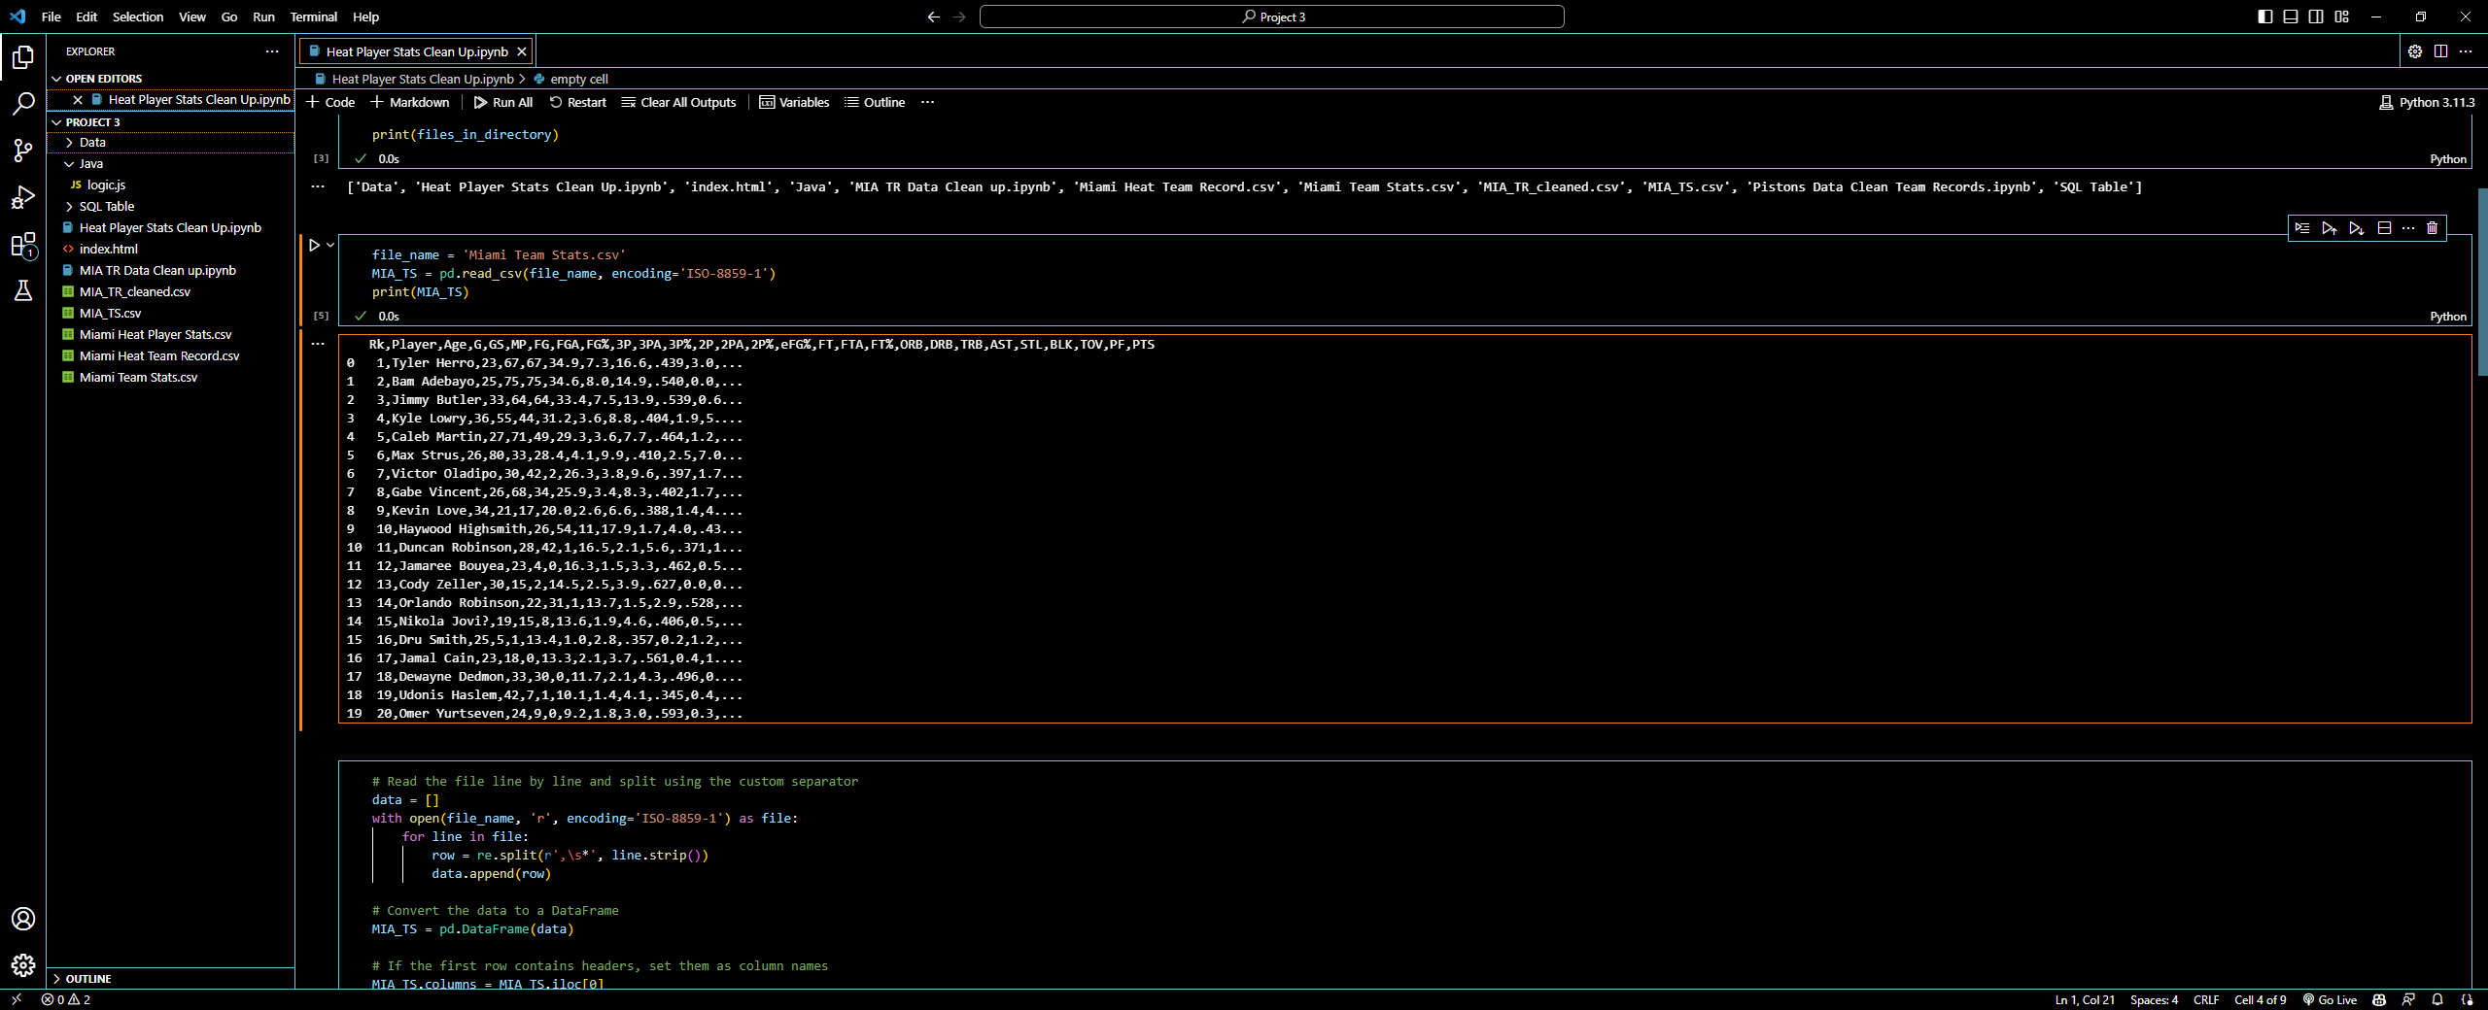
Cleaning The Data
First, we cleaned our data using python.
By using a Jupyter notebook we were able to clean our data and check each step to minimize the chance at errors.

Slide 6
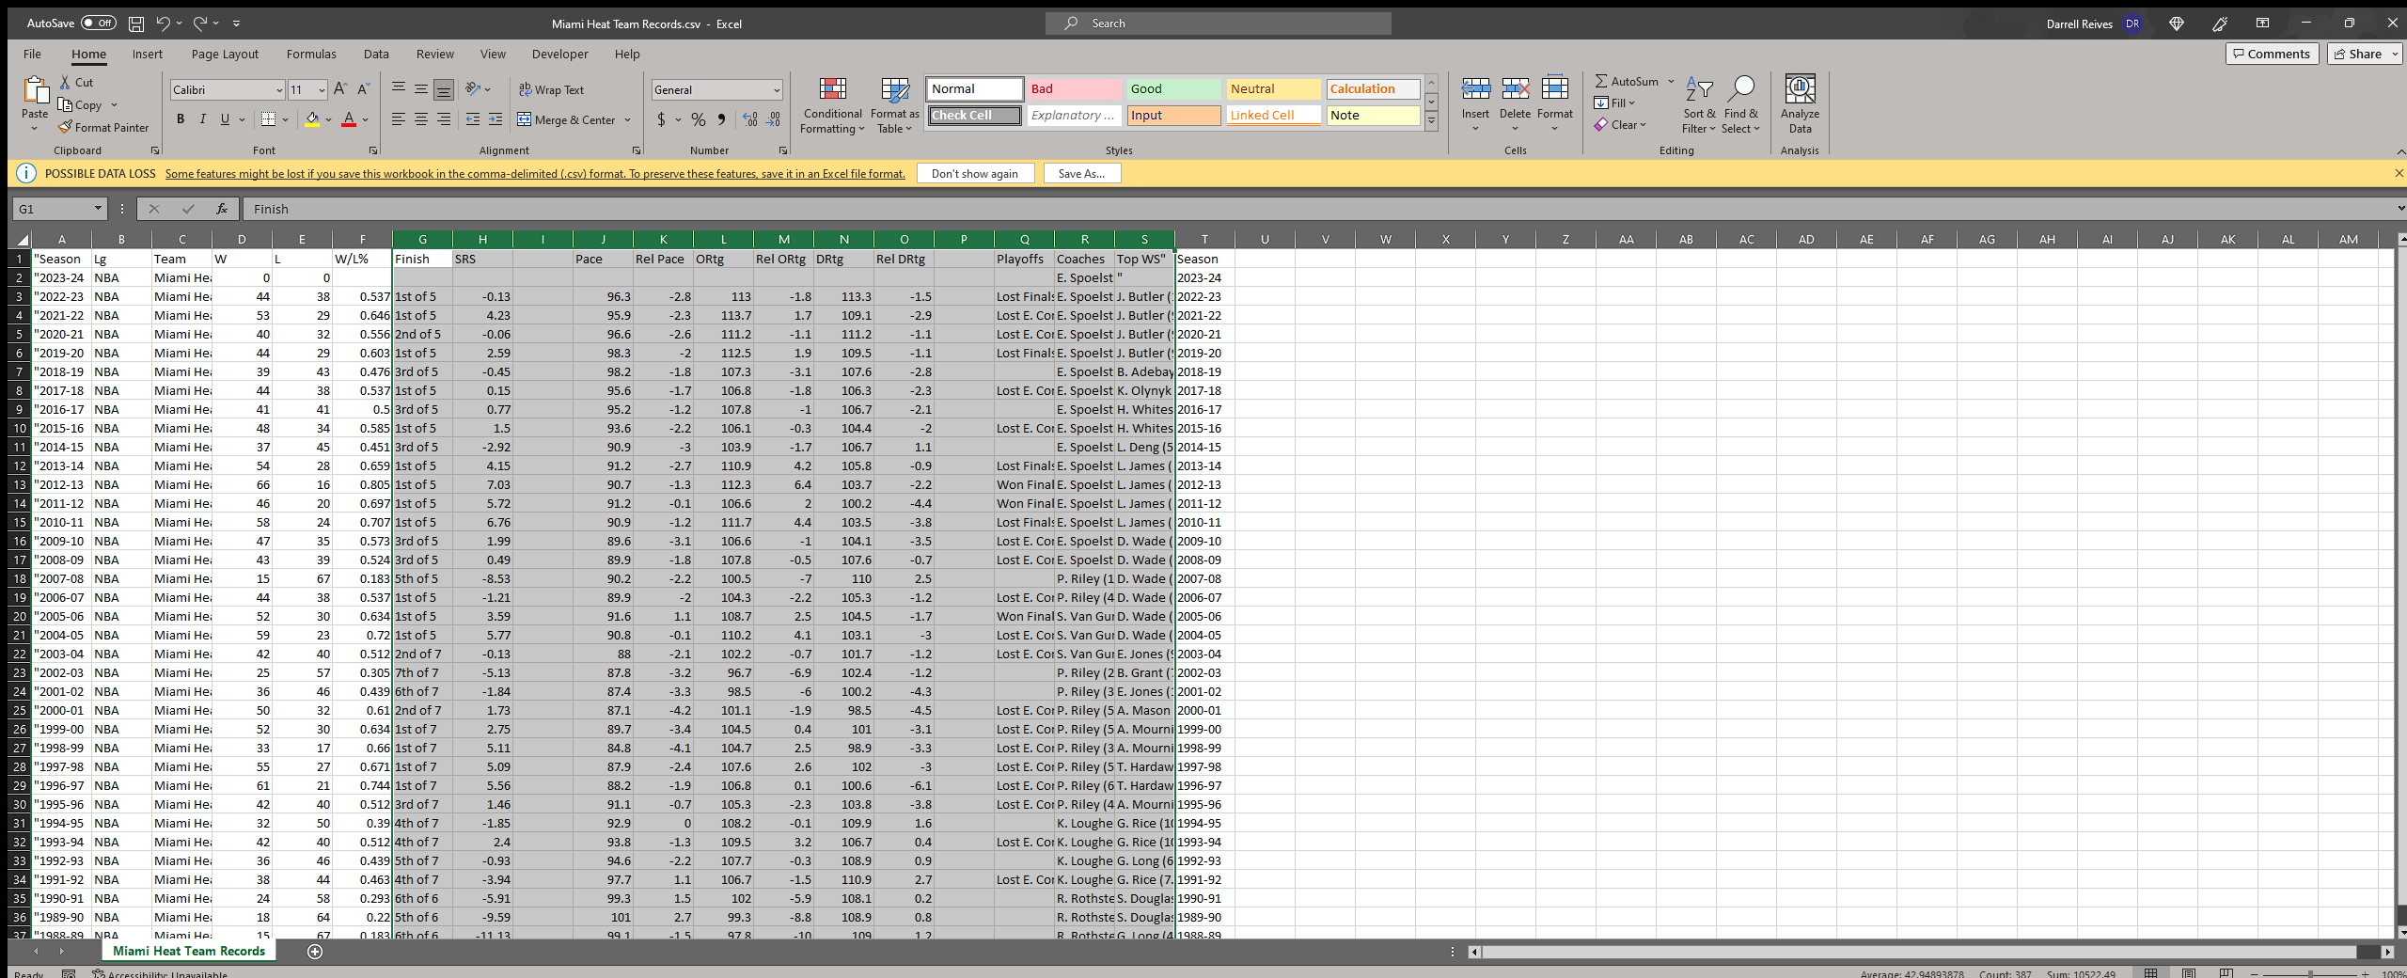
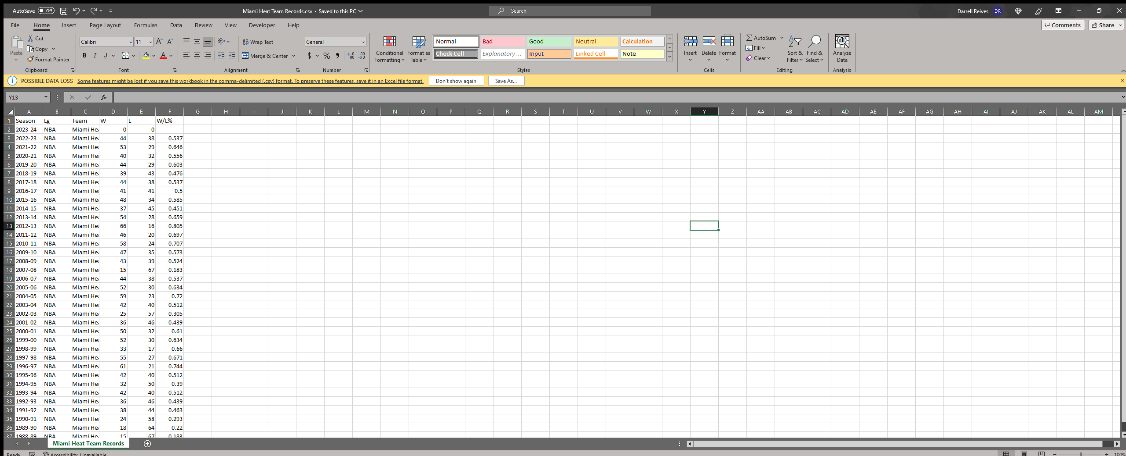

Cleaning The Data PT 2
After printing the cleaned up data into a CSV file we double checked the data and made sure there was nothing that would give us an error.
Some of us chose to do this inside Excel since it was easier to do and needed less lines of code.

Slide 7
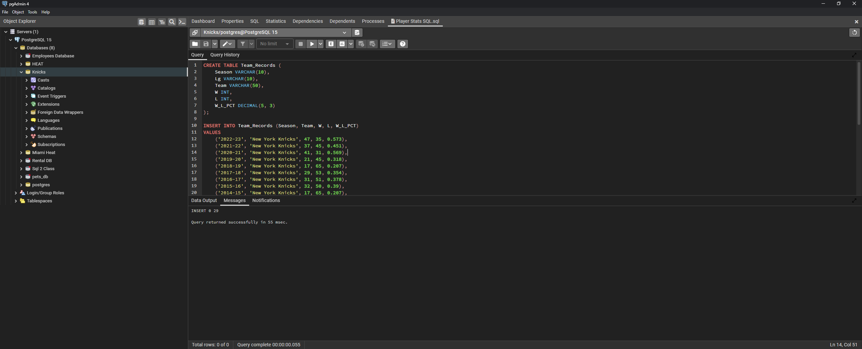
Importing to SQL
From there we inserted it into SQL
Some were able to upload it to SQL with the import command others were not so lucky.
For those we created a “Insert Into” command for the Teams Records and Player Stats.
-with help from the others...we are not that evil.

Slide 8
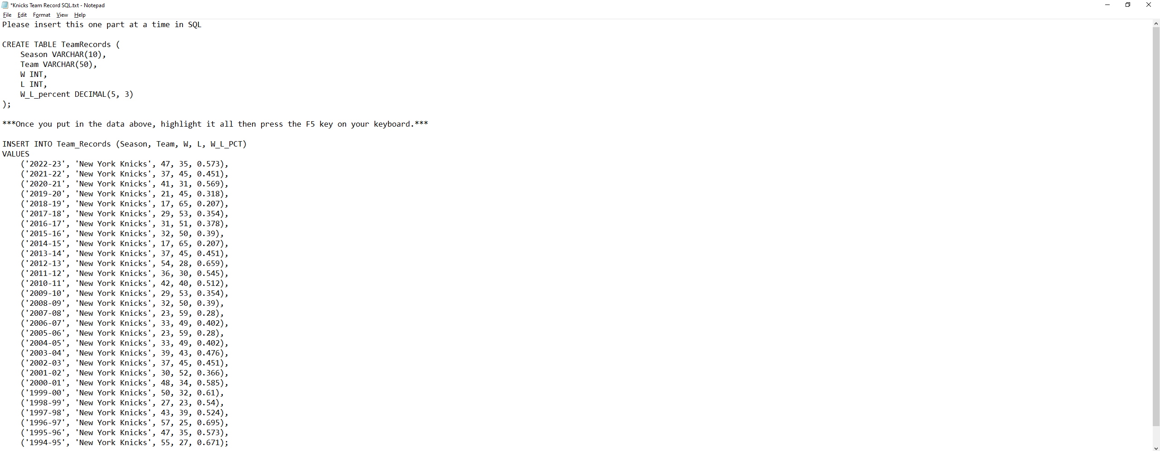
MORE SQL…
Here is just the SQL Query for just one Teams Record

Slide 9
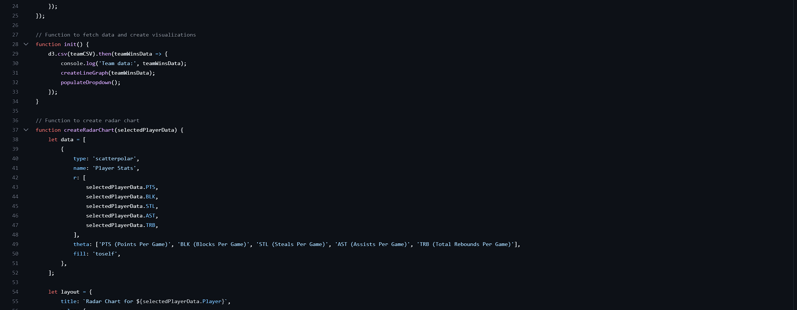
After the data was scrubbed and cleaned.
It was inputted into code.
Thanks to Andrew. You the man.

Slide 10

We now present to you ….

